Slide 1
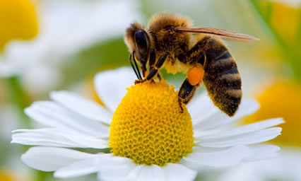
HONEY BEES
Ms. Madlon

Slide 2
Bees… in general
There are over 20,000 species of bees in the world.
They are found on every continent except Antarctica.
Most bees are communal – they live with many other bees in a colony.
They are all very important to our world! Let’s learn how!

Slide 3
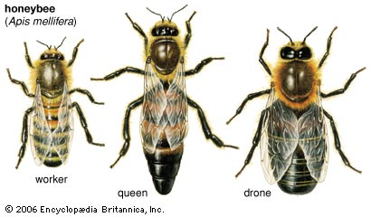
Castes of the Honey Bee
Colonies of bees have different jobs that need to be filled. Instead of each bee fulfilling all of the jobs, they are broken up into 3 different castes (jobs).
Queen bee
Worker bee
Drone

Slide 4
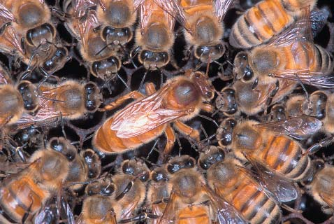
Queen Bee
There is only one queen per hive. The queen is the only bee that lays eggs. A queen bee can live for 3-5 years. She lays up to 2000 eggs per day. Some eggs become worker bees, some become drones. When she dies or becomes unproductive, the other bees will "make" a new queen by selecting a young larva and feeding it a diet of "royal jelly". For queen bees, it takes 16 days from egg to hatching.
What is royal jelly?
The powerful, milky substance that turns an ordinary bee into a Queen Bee. It is made of digested pollen and honey or nectar mixed with a chemical secreted from a gland in a nursing bee's head.

Slide 5
Worker Bees
All worker bees are female, but they do not lay eggs.
Worker bees live for 4-9 months during the winter season, but only 6 weeks during the busy summer months (they literally work themselves to death).
Nearly all of the bees in a hive are worker bees. A hive consists of 20,000 - 30,000 bees in the winter, and over 60,000 - 80,000 bees in the summer.
Jobs:housekeeper; nursemaid; construction worker; grocer; undertaker; guard; and finally, after 21 days they become a forager collecting pollen and nectar.
The worker bee has a barbed stinger that results in her death following stinging, therefore, she can only sting once.

Slide 6
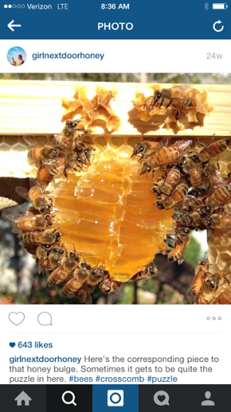
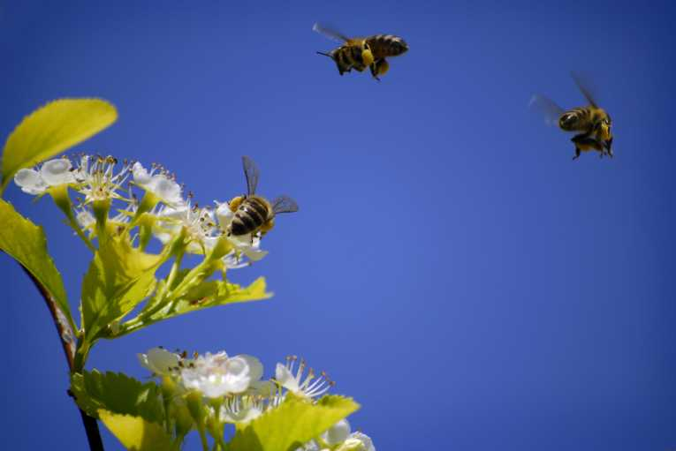
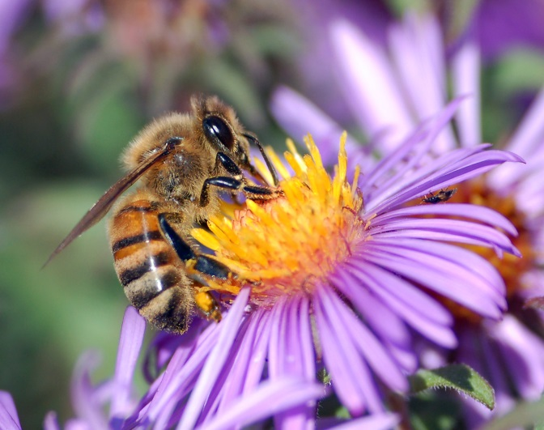
Honey bulge – the result of the
hard work of the worker bees!

Slide 7
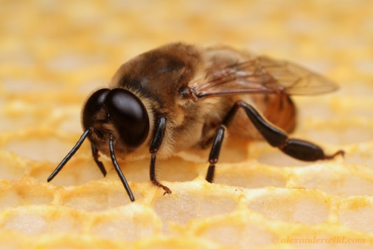
Drones
Drones do not have a stinger, nor do they do any of the work in a hive.
Drones are simply there to be the dad of the new bees.
There are only 300 – 3000 of them in a hive.

Slide 8
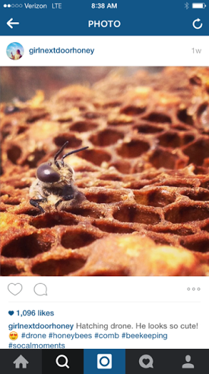
Baby bees!
Bee eggs!
A hatching drone!

Slide 9
Anatomy of a Honey Bee
Pollen sacs are also called pollen baskets.

Slide 10
OUCH!
GETTING STUNG
The "ouch" part of the honeybee. Although sharp pain and some swelling and itching are natural reactions to a honeybee sting, a small percentage of individuals are highly allergic to bee venom.
BEE VENOM THERAPY
"Bee venom therapy" is widely practiced overseas and by some in the USA to address health problems such as arthritis, neuralgia, high blood pressure, high cholesterol and even MS.

Slide 11
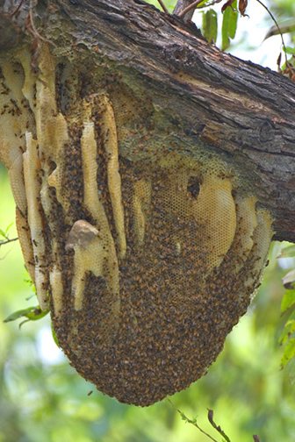
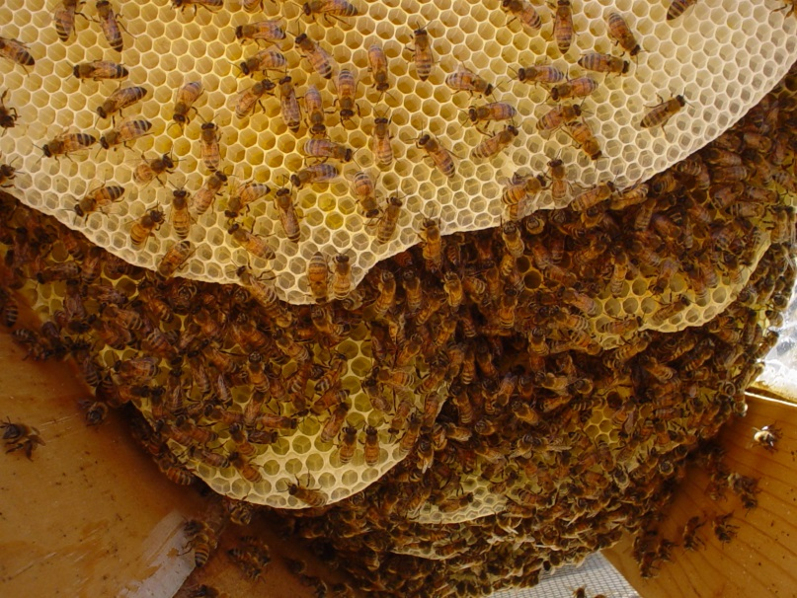
Hives
The hive of honeybees is made of something called honeycomb.
Honeycomb is made by bees chewing wax until it is soft.
Honeycomb starts off as white, but as the bees cover it with their saliva, nectar, and honey, it becomes a yellow color.

Slide 12
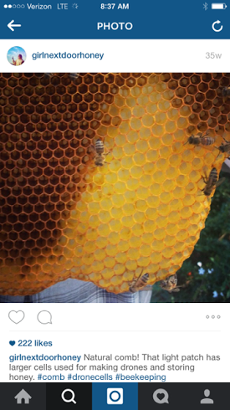
Honeycomb
White to yellow.
Different cells are used for different things. Some for making honey, some for bee eggs.

Slide 13
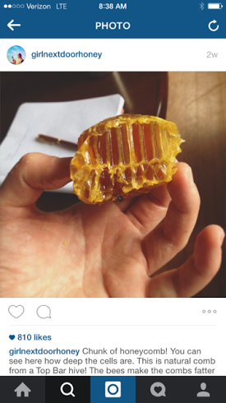
Inside the Honeycomb
Each cell is pretty deep and can store a decent amount of honey.

Slide 14
Honey
Bees make honey because that is their food.
How far does a hive of bees fly to bring you one pound of honey? Over 55,000 miles. How much honey does the average worker honey bee make in her lifetime? 1/12 teaspoon. – Think about that the next time you eat honey! A bee worked extremely hard to produce that!
“Honey is bee vomit. It takes at least 100,000 vomits to make 1 pound of honey.” Sucrose must convert into glucose and fructose, and moisture must evaporate for nectar to ripen into honey, Ball said. House bees place the nectar in cells within the hive for one to three days until it contains about 20 percent moisture. Then it’s ready to be eaten!

Slide 15
How do bees pollinate?
Bees collect pollen as they land on plants on the hairs on their legs (pollen baskets). They plan to take this pollen back to the hive, but as they continue to land on other plants, some pollen stays there and pollinates!
So remember to thank and appreciate bees! Don’t try to kill them or disturb them! They are SO IMPORTANT to our lives!

Slide 16
Why are bees important?
Agriculture depends greatly on the honeybee for pollination.
Honeybees account for 80% of all insect pollination. Without such pollination, we would see a significant decrease in the yield of fruits and vegetables.

Slide 17
A world without bees…

Slide 18
A world without bees…

Slide 19
Beekeeping… Why keep bees?
To make and sell honey
TO KEEP BEES IN OUR COMMUNITY!
So often, people find bees in their yard and kill them to remove them. This is detrimental to our community, as bees are very important!
Also, RESPONSIBLE bee keepers are SUPER knowledgeable about bees and can do wonderful things like remove bees from your yard without killing them!

Slide 20
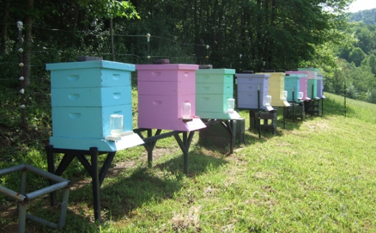
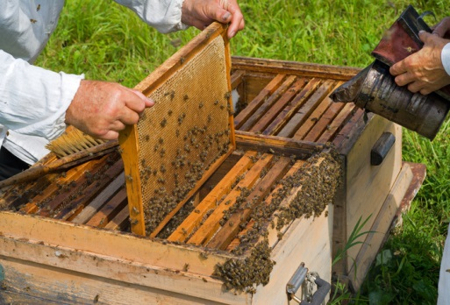
Domestic Bee Hives

Slide 21
Bee removal!
This RESPONSIBLE bee keeper (Hilary Kearney) is removing a hive. She is moving it WITHOUT killing the bees! Sometimes in moving a hive, a few bees will die (especially from attempting to sting the movers). But in general it is usually better for the WHOLE hive to be moved somewhere safer.

Slide 22
Find the Queen (1)
Can you find the queen? Make your guess and then go to the next slide to see if you were right!

Slide 23
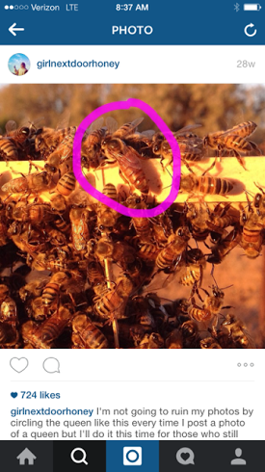

Slide 24
Find the Queen (2)
Try another! Make your guess and then move to the next slide to see if you were right!

Slide 25
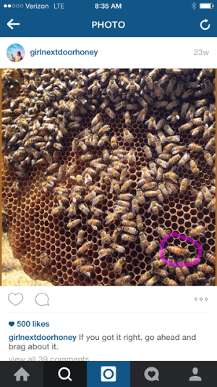

Slide 26
Find the Queen (3)
Try one more! This is a hard one! Make your guess and then go to the next slide to see if you’re right!

Slide 27
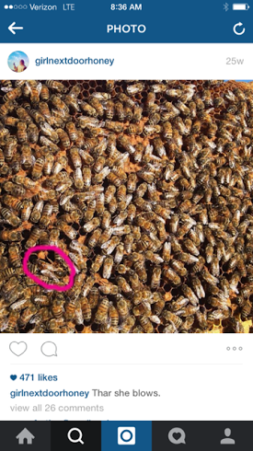

Slide 28
Remember – Respect the Bees!

Slide 29
Resources
http://girlnextdoorhoney.com/
http://www.backyardbeekeepers.com/facts.html
http://thehomeschoolscientist.com/honey-bee-anatomy-printable-lesson/#.VUp-HflVgSU

